Slide 1
Improving the quality of non-profit financial reports while reducing the burden of multiple formats.

Slide 2
The problem Broken financial reporting system
Wasted time, money & missed opportunities for impact
TRUST
No easy way to build financial trust between donors and NGOs
Inconsistent financial reports
Don’t meet funders’ needs
High costs – funders and grantees
Lack of transparency
Fear of double funding fraud

Slide 3
The solution

Slide 4
INPAS in a nutshell
The International Non-Profit Accounting Standard (INPAS) will be the first internationally recognised accounting standard for the sector, developed to streamline the preparation of annual audited accounts and grant reports by Non-Profit Organisations (NPOs / NGOs).
After publication in September 2025, its use will enhance transparency and accountability, strengthening trust and global credibility — unlocking greater impact and sustainability.

Slide 5
Completing the suite
IFRS (Corporates)
Name: International Financial Reporting Standards and IFRS for SMEs
IPSAS (Governments)
Name: International Public Sector Accounting Standards
INPAS (Non-Profits)
Name: International Non-Profit Accounting Standard
Since 1973
Since 1997
From 2025

Slide 6
Value prop!
For NGOs: Simplifies and standardizes financial reporting, making it easier to measure and manage financial sustainability, comply with donor reporting requirements, and attract quality funding.
For Funders: Provides confidence in the financial integrity of NGOs, facilitating more informed funding decisions, and streamlined accountability for grants.
For Auditors: Offers a clear, consistent framework for auditing non-profit financial statements, reducing ambiguity and increasing audit quality.

Slide 7
Current situation
Whole of entity reports
Grant reports
Bankers
Suppliers
Regulator
Funder 1
Partners
Tax authority
Funder 2
Employees
Potential funders
Board members
Funder 3
Grantees
Civil society
Service users
Notes:
Dotted line on the left shows General-purpose financial reports are of limited usefulness to most stakeholders
On the RHS we can see different formats for each donor – these are called special purpose financial reports. They meet the needs of one user only.
No link between them, even tho they are supposed to come from same accounting system

Slide 8
Future with INPAS
Useful reports
Harmonised grant reports
Bankers
Suppliers
Regulator
Funder 1
Partners
Tax authority
Funder 2
Employees
Potential funders
Board members
Funder 3
Grantees
Civil society
Service users
Notes:
General-purpose financial reports more useful to range of stakeholders (power shift and impact!)
Single format for donor reporting (reduced burden on NPOs)
Bridge / link between them (increased assurance for Funders)

Slide 9
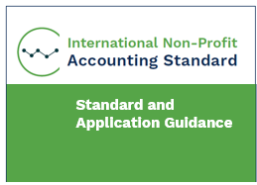
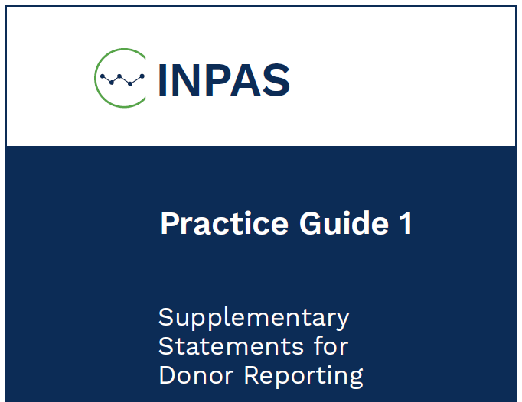
INPAS vs Practice Guide 1
INPAS for whole-of-entity financial reporting.
≈ 300 pages
Principles based
Measurement
Recognition
Disclosure
Accompanying narrative report
Countries / regulators
NGO
PG1 for Harmonized Grant Geporting
≈ 8 pages
Rules based
Harmonized expenditure headings
Reconciliation to main audited accounts
Financial info only
Funders
Notes:
Adoption of INPAS will be driven by country regulators, for NGOs in their jurisdicitons
Adoption of Practice Guide 1 will be driven by funders (and NGOs themselves)

Slide 10
Practice Guide 1 in a nutshell
PG1 is financial reporting guidance for grant reporting
PG1 is a document, published with INPAS
It prescribes a standard format report with notes and specific requirements
Not mandatory for INPAS compliance
Format may be used without INPAS
Grantors may require, allow or refuse its use by their grantees

Slide 11
Adopting Harmonized Grant Reporting
INPAS
International Non-Profit Accounting Standard
HGR
Practice Guide 1: Supplementary Statements for Grant Reporting
All NPOs
INPAS and PG1 may be used separately, but greatest benefits arise when used together

Slide 12
Primary audience for INPAS
Tier 1 NPOs – Full IFRS or equivalent
Tier 2 NPOs - INPAS
Tier 3 NPOs – cash based likely to be sufficient
Very small local CBOs not primary audience for INPAS
PG1 useful even for very small NGOs

Slide 13
Into the weeds INPAS Practice Guide 1: Supplementary Statements for Grant Reporting

Slide 14
PG1 Prescribed format 1
Statement for activity X | Note | NPO Currency
Income
Grants and donations | 1
Other income (by type) | 2
Total income |  | 100,000
Expenses
Employment | 3
Travel and subsistence | 4
Supplies and materials | 5
Running costs, external services and other | 6
Services in-kind and gifts in-kind | 7
Grants payable | 8
 | 9
Total expenses |  | 80,000
Notes:
The heading specifies the specific sub-set of transactions that are included in the report
Standard expenditure headings means easy production of reports from accounting system
Note the format uses natural classification for direct costs (in relation to the activity in the heading) – according to inputs

Slide 15
PG1 Prescribed format 1
Statement for activity X | Note | NPO Currency
Income
Grants and donations | 1
Other income (by type) | 2
Total income |  | 100,000
Expenses
Direct expenses
Employment | 3
Travel and subsistence | 4
Supplies and materials | 5
Running costs, external services and other | 6
Services in-kind and gifts in-kind | 7
Grants payable | 8
Support costs | 9
Total expenses |  | 80,000
Notes:
And there is the option to have a separate line for support costs – which is classification by function.
Under INPAS NGOs don’t have to use these same headings for their main audited accounts, on the Statement of Income & Expenses, but smaller ones are encouraged to do so if it makes sense for them, and this makes it much easier to manage the budgeting and reporting for the organisation across many different funding sources.
PG1 includes guidance for what to include under each of the headings, and further breakdown can be provided in the notes if needed.
If funders accept the use of PG1, they can’t change these 6 headings. That defeats the point, but they can require additional information in the notes. The more additional information is required, the more the time saving benefits of PG1 harmonisation are eroded.

Slide 16
PG1 Prescribed format 2
Total income 100,000
–
Total expenses
80,000
Agrees to ‘Movement in Funds’ note in NPO Main accounts
Statement for activity X (continued) | Note | NPO Currency
Foreign currency translation gains/losses |  | -
Transfers |  | -
Other financial movements |  | -
Change in grant [fund] balance |  | 20,000
Opening balance |  | -
Closing balance |  | 20,000
Notes:
Continuation of the statement
For the reconciliation to the main accounts to work
Same period
Same currency
Same accounting policies
If NPO is using INPAS, then the accounting policies required by INPAS, in terms of revenue recognition, accrual accounting etc, also need to be applied in the PG1 report.
If donor needs info on a cash basis, PG1 includes guidance about a standard format note to provide a reconciliation, for income and for expenses if needed.

Slide 17
Linkage to main audited accounts Movement in funds note
 | Opening balance | Income | Expenditure | Transfers between funds | Closing Balance
Restricted funds
Fund A | - | 100,000 | 80,000 | - | 20,000
Fund B
Unrestricted funds
TOTAL
Notes:
This is a note in the main financial statements, required by INPAS.

Slide 18
Column options - donor
Statement for activity X | Note | NPO currency | Donor currency | Donor budget
Income |  | 100,000
Expenses |  | 80,000
Change in grant [fund] balance |  | 20,000
Opening balance |  | -
Closing balance |  | 20,000
Notes:
Without changing the core format and requirements for reporting historical actuals in NPO currency for the period, there is huge flexibility for funders in terms of choosing which other columns they would like to see.

Slide 19
Column options - periods
Statement for activity X | Note | Month 1-6 | Months 7-12 | NPO currency
Income |  |  |  | 100,000
Expenses |  |  |  | 80,000
Change in grant [fund] balance |  |  |  | 20,000
Opening balance |  |  |  | -
Closing balance |  |  |  | 20,000

Slide 20
Column options – funding source
Statement for activity X | Note | Source 1 | Source 2 | NPO currency
Income |  |  |  | 100,000
Expenses |  |  |  | 80,000
Change in grant [fund] balance |  |  |  | 20,000
Opening balance |  |  |  | -
Closing balance |  |  |  | 20,000

Slide 21
Core benefits of INPAS & PG1
For Funders
For NPOs
Greater assurance on grant usage through reconciliation to main accounts
Streamlined due diligence with more relevant information in standard reports
Enhanced transparency across restricted and unrestricted grants
Improved consistency in financial reporting formats
Standardized budget headings for easier comparison
Reduced reporting burden with a single reporting format across funders
Increased credibility and visibility, helping small and local NPOs compete for funding
Better insight into financial sustainability, support costs, and true project costs
Clearer financial communication for board members, grant officers, and community members
Relevant support from training and software providers focused on NPO-specific needs

Slide 22
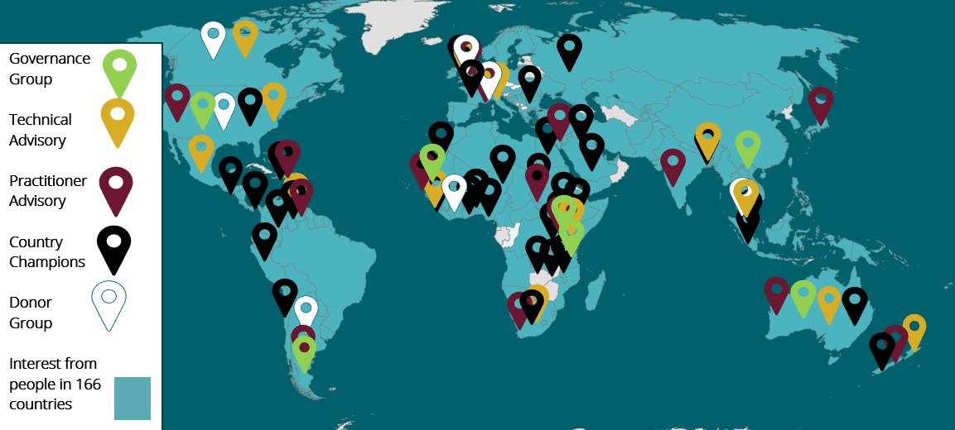
Engagement around the world
15,000+
Newsletter subscribers
+ LinkedIn & YouTube

Slide 23
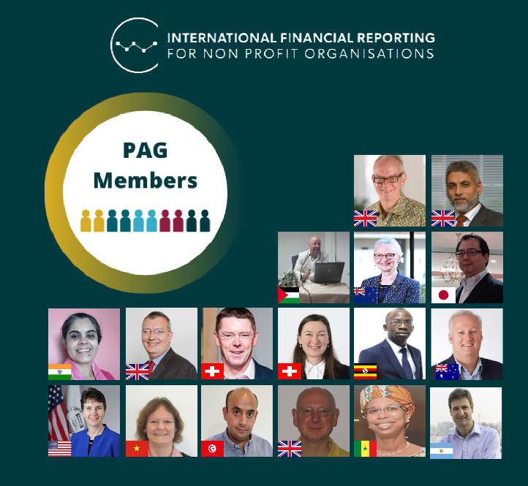
By the sector, for the sector
Multi-year initiative, to secure international buy-in
2019 project launch - 2025 publishing INPAS
Input from volunteer advisory and reference groups
Technical Advisory Group (TAG) – national accounting standard setters from every continent (and IASB as official observers)
Practitioner Advisory Group (PAG) – NPOs, auditors, consultants, academics
Donor Reference Group with bilateral and multi-lateral funders and foundations.
Engagement supported by 45 volunteer Country Champions
Oversight by independent Governance Group

Slide 24
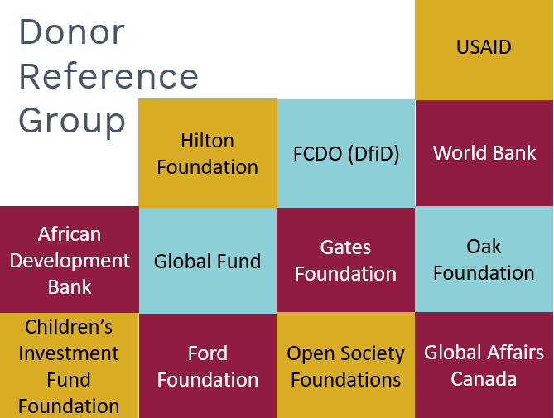
Donor engagement
Funding from
Input from
Donor statement of support

Slide 25
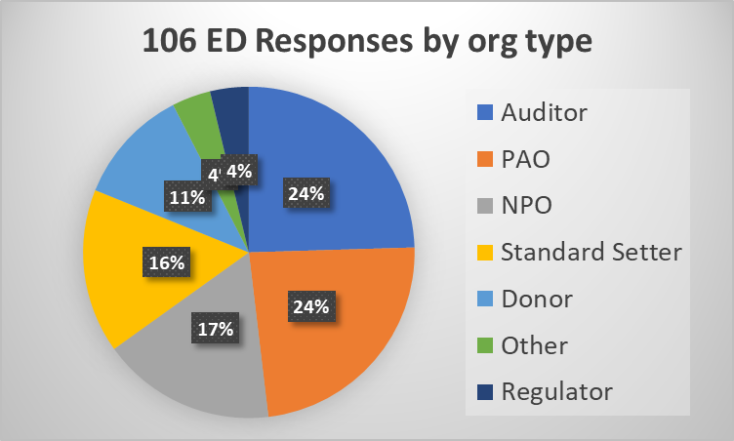
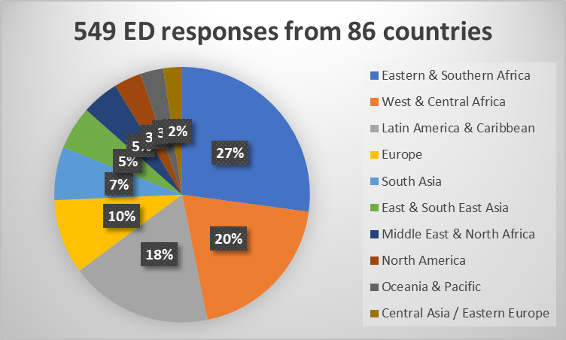
Exposure Draft responses
Geographic diversity
Stakeholder representation
Quantity & Quality
3 EDs 2022, 2023 & 2024
549 responses
179 written comment letters (106 organisations + 73 individuals)
370 surveys

Slide 26
Identification and inclusion with NGO Main Accounts
Clearly separated
Annex?
Audit status
Notes:
A number of questions remain here. NGOs may agree with their donors to publish a particular grant report as an annex to the main audited accounts. It would need to be clearly separated, and there would need to be clear statements about what is or is not covered by the audit opinion. This opens up a pathway to single audit.

Slide 27
Adoption sequencing
NGO
Funder 1 requires PG1 format
Funder 2 allows PG1 format
Regulator allows use of INPAS
Funder 3 requires use of INPAS
Funder 3 requires SS
Regulator requires use of INPAS
The NGO needs to respond to its funders and national regulators
One or more funders may allow or require use of the HDR format
The regulator may allow or require INPAS for entity reporting
One or more funders may allow or require preparation of full Supplementary Statement
If an NGO is allowed to adopt INPAS, a funder requirement to do so could be an important driver.
May happen in any order and over a number of years.
Most benefits when NGO uses INPAS, and all funders use SS

Slide 28
The vision A non-profit sector where financial reports build trust, unlocking potential for funding and impact
Improve quality and reliability of financial reports
Reduce burden of multiple formats
Notes:
Getting to the root cause of some deep inequity that’s been built into the financial reporting ecosystem.

